Slide 1


Counterfactuals as Explanations for Monotonic Classifiers
ICCBR XCBR Workshop 2022
Authors: Sarathi K, Shania Mitra,
Deepak P, Sutanu Chakraborti

Slide 2
What are Counterfactuals?
Source: Google Images

Slide 3
Considerations for Good Counterfactuals
Plausibility Counterfactuals should not suggest changes to feature values that are unrealistic
Sparsity Generation of counterfactuals must make changes to the fewest possible features
Diversity Generation of multiple counterfactuals that are sufficiently diverse with respect to each other to enhance flexibility
Prolixity Overgeneration of potentially superfluous counterfactuals should be avoided

Slide 4
Background
The most commonly adopted approaches use convex optimization, but these are expensive to solve for multiple queries
Perturbation-based approaches disturb the input until a point of the opposite class is obtained
In this work, we enhance the method proposed by Keane et al. referred to as GCF (Good Counterfactual)
GCF generates counterfactuals using a classical CBR approach by reusing and revising the explanation cases close to the query
We also experiment with monotonicity in features to address domain constraints

Slide 5
Problem Statement
To generate counterfactuals that:
Are realistic and incorporate domain knowledge in the form of monotonic constraints
MIB: More increases chances of desired class
LIB: Less increases chances of desired class
Make changes to actionable features only
Have a sparsity of 2 or 3 features only

Slide 6
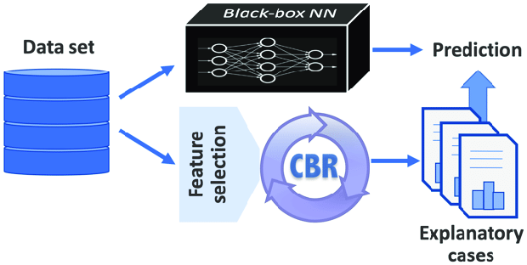
Twin Systems Approach
A black box model is mapped to a white box “twin” that is more interpretable, with both systems using the same dataset
Any classifier could be used to twin with the CBR system, but we advocate the use of monotonic classifiers
Source: Google Images

Slide 7
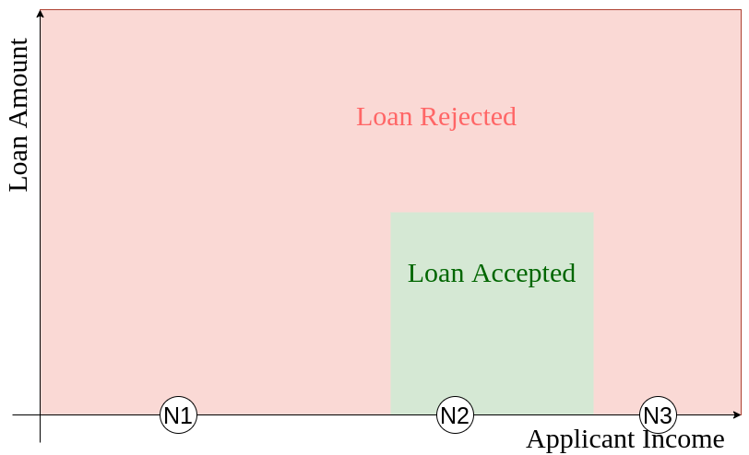
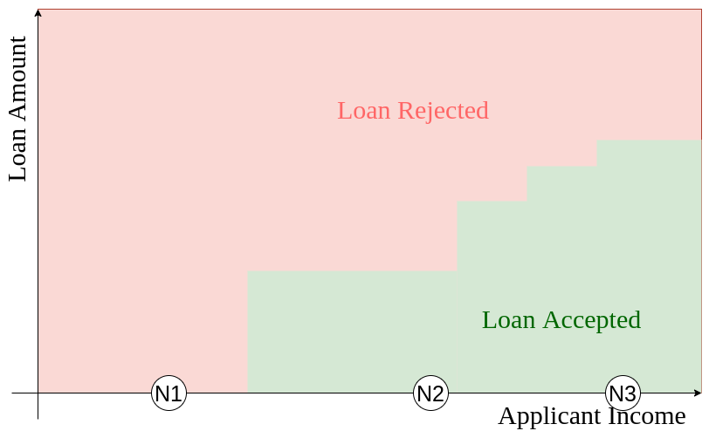
Need for Monotonic Constraints in Classifiers
As applicant income increases, chances of loan approval should increase
Does not generalise well outside training set
May generate implausible results

Slide 8
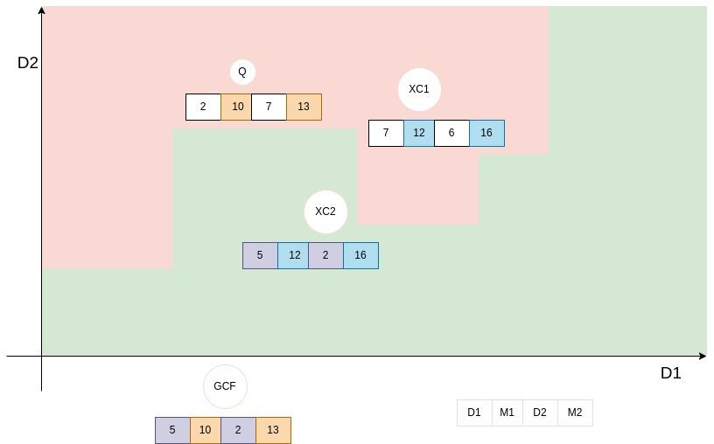
Baseline Method: GCF
Attribute values are copied from case base but this may not satisfy causal constraints
Plausible solutions, closer to the query, exist for the MIB/LIB case
,
D1
M1
D2
M2
D1
M1
D2
M2
D1
M1
D2
M2
Source: Good Counterfactuals and Where to Find Them (Keane et al.)

Slide 9
Proposed Approach: Monotonic constrained Bound Corner counterfactuals (MBC)
Monotonicity is imposed on the features, wherever applicable
The difference features are chosen from among the monotonic features in a manner similar to the baseline method (D1, D2 from the previous example)
All difference feature dimensions are explored to see if counterfactuals closer than GCF can be obtained (Eg. CF1)
All skyline points are explored by sliding a grid (2x2) across the difference feature space (Eg. CF2, CF3 and CF4)

Slide 10
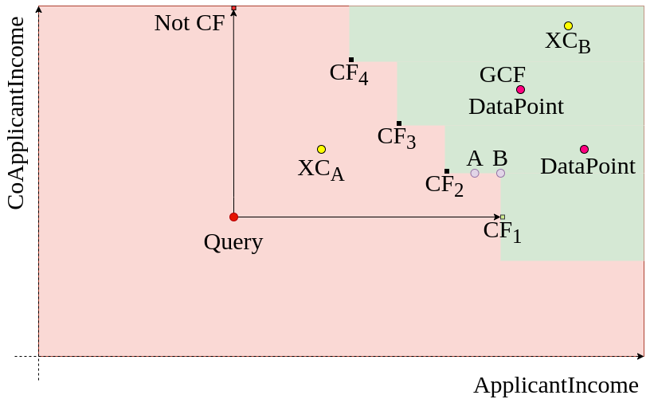
Proposed Approach: Monotonic constrained Bound Corner counterfactuals (MBC)
Skyline corners in the decision boundary of the difference features are effective counterfactuals
,

Slide 11

Why are Skyline Corners Sufficient?
B
A
C1
C2
Points A and B can be perturbed to C1, C2
At C1, C2, the loan is approved for lower applicant income and co-applicant income

Slide 12
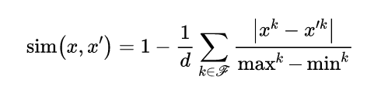
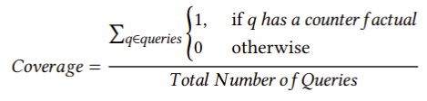
Experiments
Datasets:
Loan Approval
Wine Quality
Employee Attrition
Performance Measures:
Similarity to Query
Similarity to Data
Coverage
Models: GCF/MBC
Without monotonic constraints
With monotonic constraints
Sparsity = 2
Sparsity = 3
Sparsity = 2
Sparsity = 3

Slide 13

Results: Loan Approval Data Set
Dataset: 614 instances and 12 attributes
All variants of 𝑀𝐵𝐶 outperform the corresponding variants of 𝐺𝐶𝐹 with respect to 𝑆𝑖𝑚-𝑞𝑢𝑒𝑟𝑦 and 𝐶𝑜𝑣𝑒𝑟𝑎𝑔𝑒
𝐺𝐶𝐹 variants have a higher similarity to data
Coverage of MBC variants significantly higher than GCF variants

Slide 14
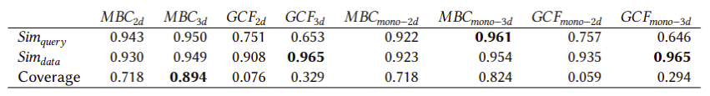
Results: Wine Quality Data Set
Dataset: 178 instances and 12 attributes, multiclass classification
𝑀𝐵𝐶 outperforms 𝐺𝐶𝐹 in terms of 𝑆𝑖𝑚𝑞𝑢𝑒𝑟𝑦 and coverage
𝐺𝐶𝐹 marginally outperforms 𝑀𝐵𝐶 in terms of 𝑆𝑖𝑚-𝑑𝑎𝑡𝑎
Monotonic Constraints do not add as much value
Eg. In MBC-2d, 𝑆𝑖𝑚𝑞𝑢𝑒𝑟𝑦 and 𝑆𝑖𝑚-𝑑𝑎𝑡𝑎 decrease with constraints

Slide 15
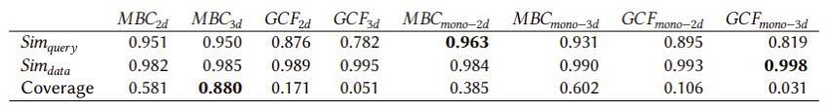
Results: Employee Attrition Data Set
Dataset: 1470 instances and 34 attributes
𝑀𝐵𝐶 outperforms 𝐺𝐶𝐹 in terms of 𝑆𝑖𝑚𝑞𝑢𝑒𝑟𝑦 and coverage
𝐺𝐶𝐹 marginally outperforms 𝑀𝐵𝐶 in terms of 𝑆𝑖𝑚-𝑑𝑎𝑡𝑎
𝑀𝐵𝐶 variants without constraints have a higher coverage

Slide 16
Conclusions and Future Directions
Presented a novel algorithm to obtain counterfactuals obeying domain constraints
Underlying machine learner modified to respect monotonic constraints
Addressed issues of sparsity, plausibility, diversity effectively
Caution needs to be exercised while imposing constraints
More efficient processes to obtain counterfactuals in the monotonic feature space that could be explored in the future

Slide 17
THANK YOU

Slide 18
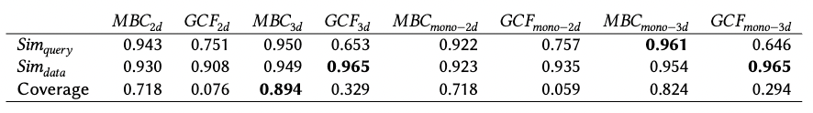
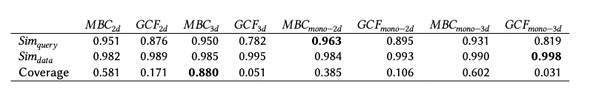
Results: Wine Quality and Employee Attrition Data Set
Wine Quality
Employee
Same trends observed as in Loan Dataset - i.e., MBC >> GCF (𝑆𝑖𝑚-𝑞𝑢𝑒𝑟𝑦, 𝐶𝑜𝑣𝑒𝑟𝑎𝑔𝑒), MBC < GCF (𝑆𝑖𝑚-𝑑𝑎𝑡𝑎)
Monotonic Constraints do not add as much value to Wine Quality
Eg. In MBC-2d, 𝑆𝑖𝑚-𝑞𝑢𝑒𝑟𝑦 and 𝑆𝑖𝑚-𝑑𝑎𝑡𝑎 decrease with constraints

